Slide 1
Dna germline (xG) pipeline
Yifei Kong and Anne Sonnenschein

Slide 2
Outline
Assay development
Pipeline overview
CNV calling and fingerprinting by massarray
QC and TSQC differences
Star allele calling (PIKE) and diplotype calling (Synapse)

Slide 3
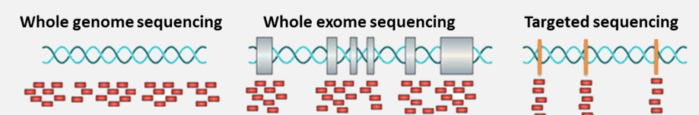
Germline genetic testing
 | WGS | WES | Panel
Bed size (bp) | ~ 3,234,830,000 | 34,402,510 (IDT_v2)
Depth (x) | 30-40 | 100-200 | 300+
Cost ($) | 1000 – 4000 | ~ 1000 | < 1000
Advantage | Good accuracy in SV calling Simplified lab procedures Once per lifetime effort | Cost effective Cover most coding regions | Most cost effective
Disadvantage | High cost in sequencing, data processing/storage Limited WGS specific annotation strategy No insurance coverage | SV calling is highly dependent on capture set and lab procedures Clinical reporting could be resource demanding | Panel specific capture probe No SV calling unless dedicated development

Slide 4
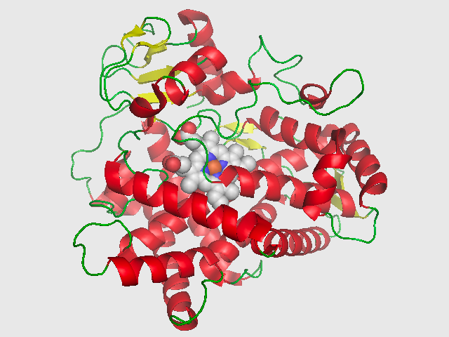
nP (neuro Psych) panel
Mental (psychiatric) disorder
Star allele nomenclature: standardize genetic polymorphism annotation of haplotype patterns defined by SNP, INDEL and CNV
Biomarker based drug selection vs traditional “trial-and-error”
Cytochrome P450 2D6 (CYP2D6)
Allele Name | Defining Name/Change | Comments | Enzyme Activity
CYP2D6*1 |  | Wild-type | normal
CYP2D6*2 | 2850C>T, 4180G>C (but these also appear in other variants) | R296C, S486T; has several subvariants | normal (except *2XN subvariant)
CYP2D6*3A | 2549delA | 259frameshift | none
CYP2D6*3B | 1749A>G, 2549delA | N166D; 259frameshift | none
CYP2D6*4 | 1846G>A | splicing defect; has several subvariants | none
CYP2D6*4F | 1846G>A, 1858C>T | splicing defect, R173C | none
CYP2D6*4G | 1846G>A, 2938C>T | splicing defect, P325L | none
CYP2D6*4H | 1846G>A, 3877G>C | splicing defect, E418Q | none
CYP2D6*5 | whole-gene deletion | CYP2D6 gene deleted | none
CYP2D6*6 | 1707delT | 118frameshift | none
CYP2D6*7 | 2935A>C | H324P | none
CYP2D6*8 | 1758G>T | G169X | none
CYP2D6*9 | 2615-2617delAAG | K281del | decreased
CYP2D6*10 | 100C>T (but also appears in other variants) | P34S | decreased
……
https://en.wikipedia.org/wiki/CYP2D6

Slide 5
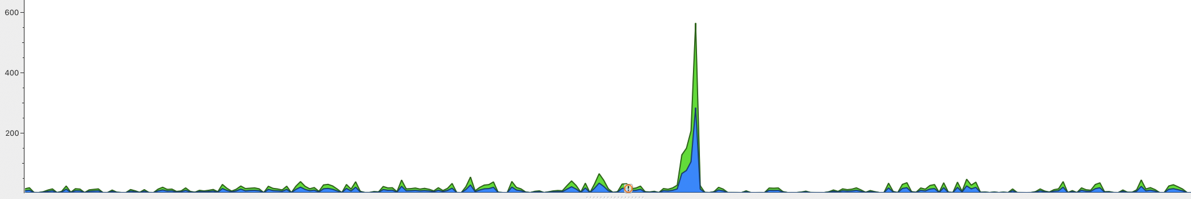
Exome backbone based product development strategy
Research/Data
Clinical report
IDT Exome capture set (v2)
WES 75x
5-10 % exome bed intervals < 20x (2% by 150x)
nP panel
276 nP define variants among 15 genes
Panel specific spike in is required for variants existing in non-coding regions
CNV of CYP2D6 (mass array)
Hereditary cancer (x)
Cardiovascular (c)

Slide 6
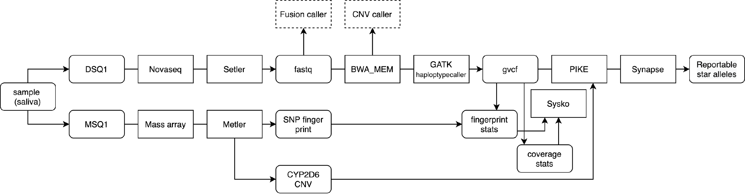
dna germline (xG/nP) workflow
Clinical geneticist
Fail
Null
PWE
Pass
xG_atlassian

Slide 7
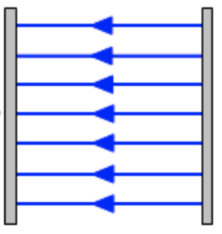
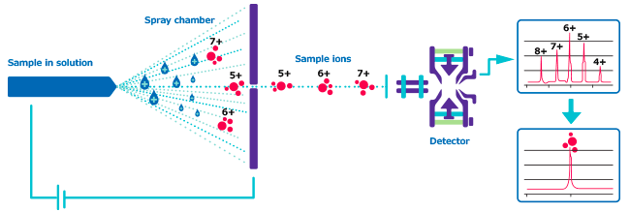
Mass spectrometry
+
-
Characterize segments by their traveling time in electric field
Break/prep sample with different mass/charge ratio
Proteomics, Metabolomics and Genomics

Slide 8
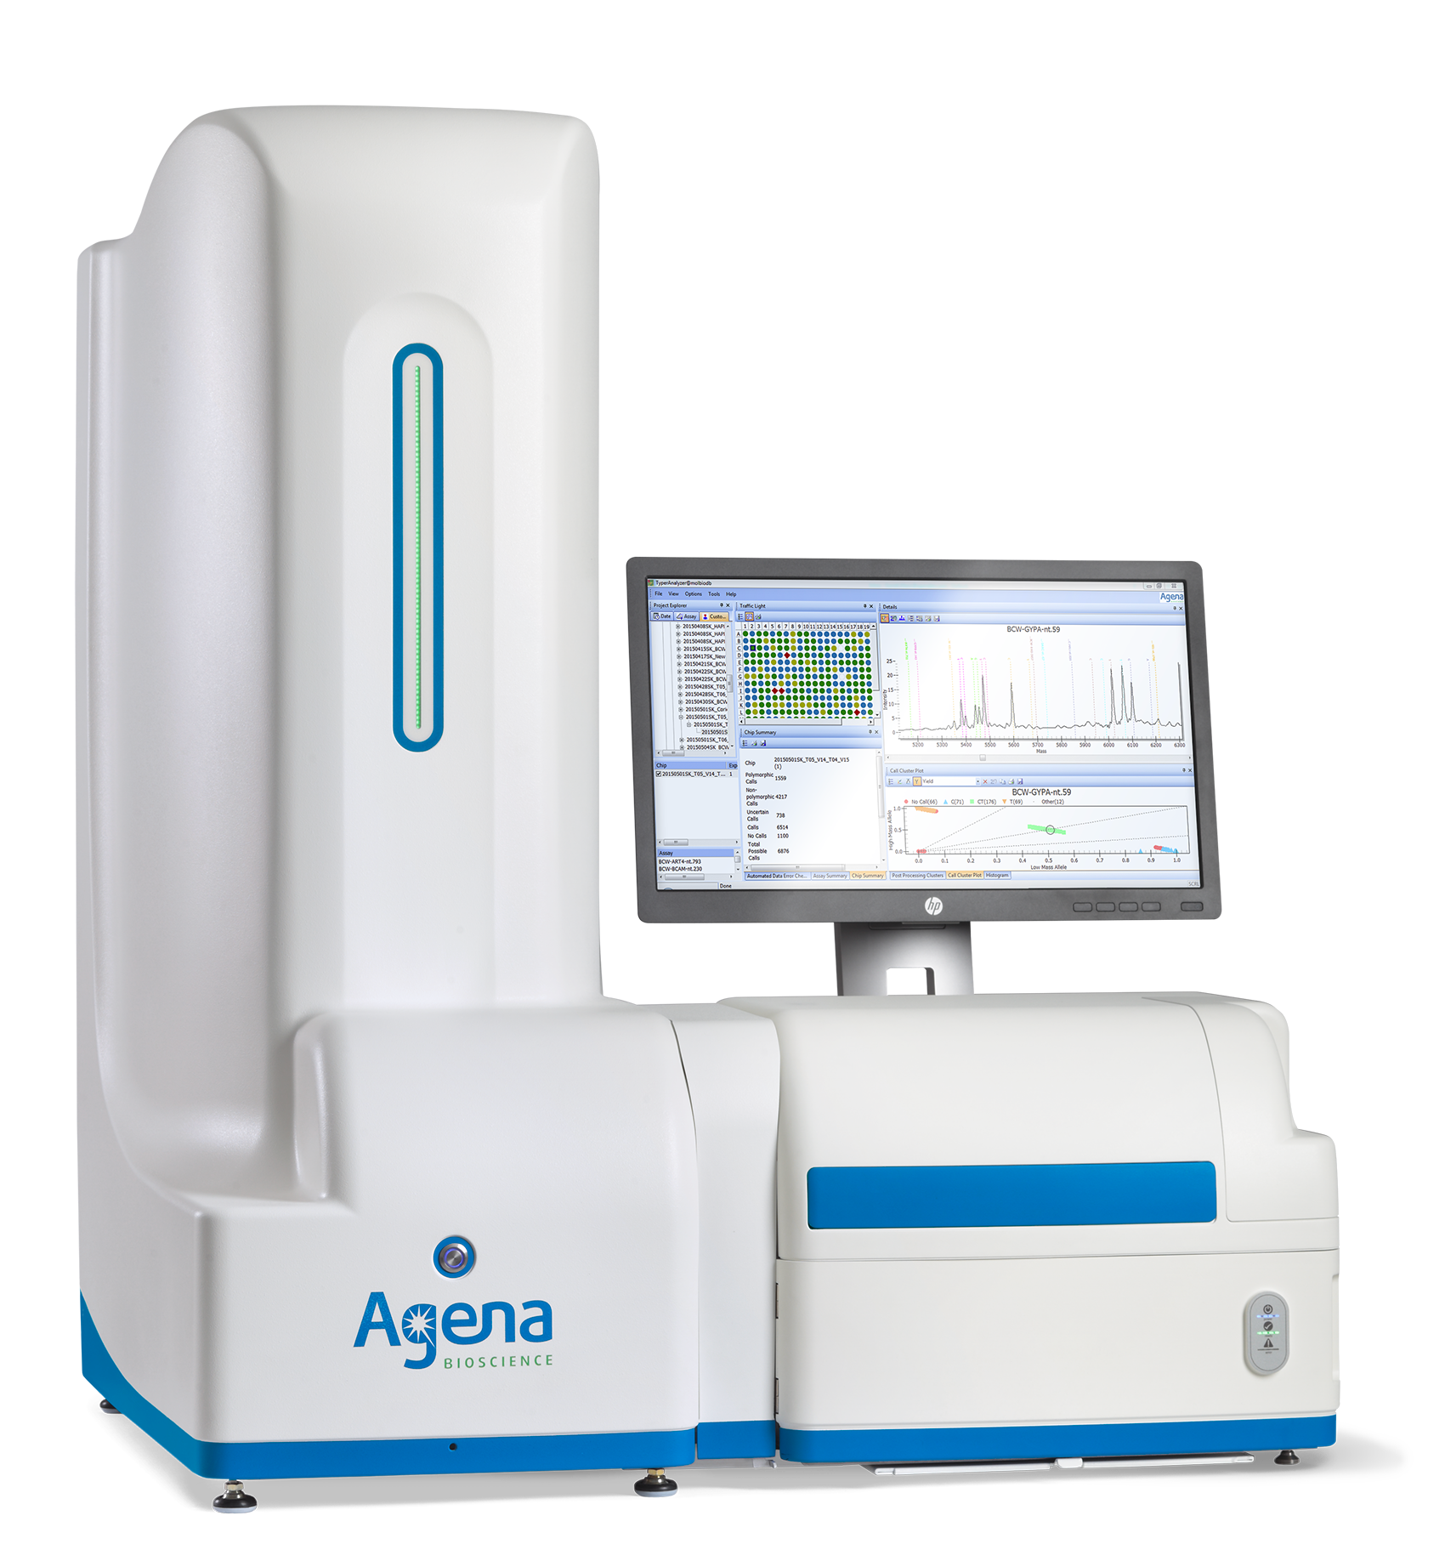
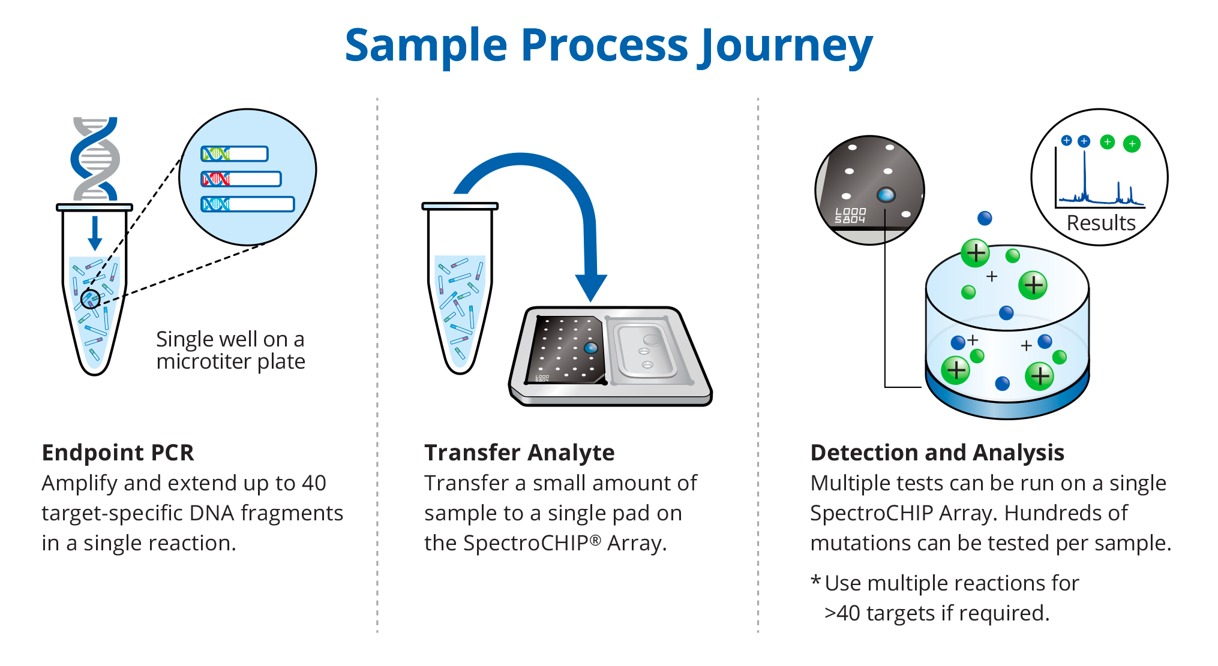
Massarray for SNP fingerprinting and CNV calling
Plate base for cost saving
Designated assays to call genotype of known variants
CYP2D6 CNV is called by controls (1/2/3N)
25 exonic SNPs for fingerprinting
High allele frequency in population
Distributed in 23 chromosomes
Overlap >= 19, concordance > 90%
Mass array SNP
High, mid confidence
Pipeline called SNP
Coverage >=10
QUAL >=100
# mass | # ngs | # overlap | # concordance | fingerprint
25 | 24 | 24 | 23 | Pass
18 | 25 | 18 | 18 | Fail
20 | 21 | 18 | 18 | Fail
24 | 24 | 23 | 20 | Fail
>= 19
concordance >=90%

Slide 9
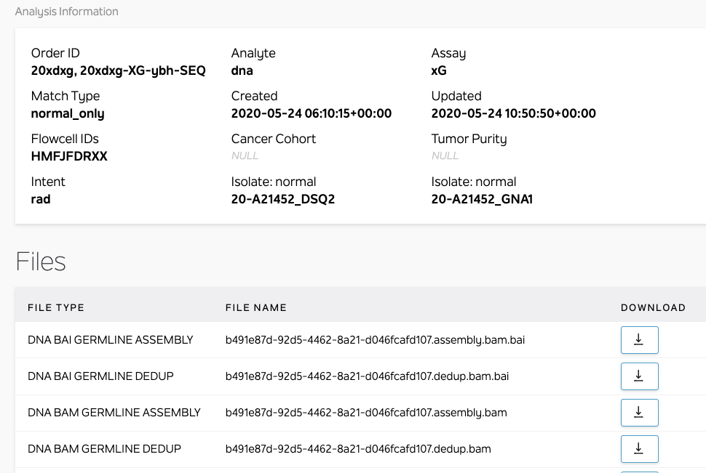
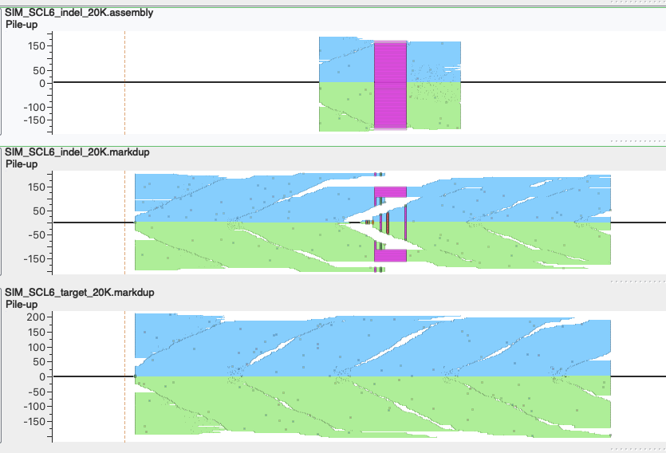
Indel detection boosted by GATK haplotypecaller
GATK haplotypecaller optimize local alignment for Indel calling
Optionally output pile-up supporting variants as bam
Realigned bam by Haplotypecaller
Bam by BWA_MEM

Slide 10
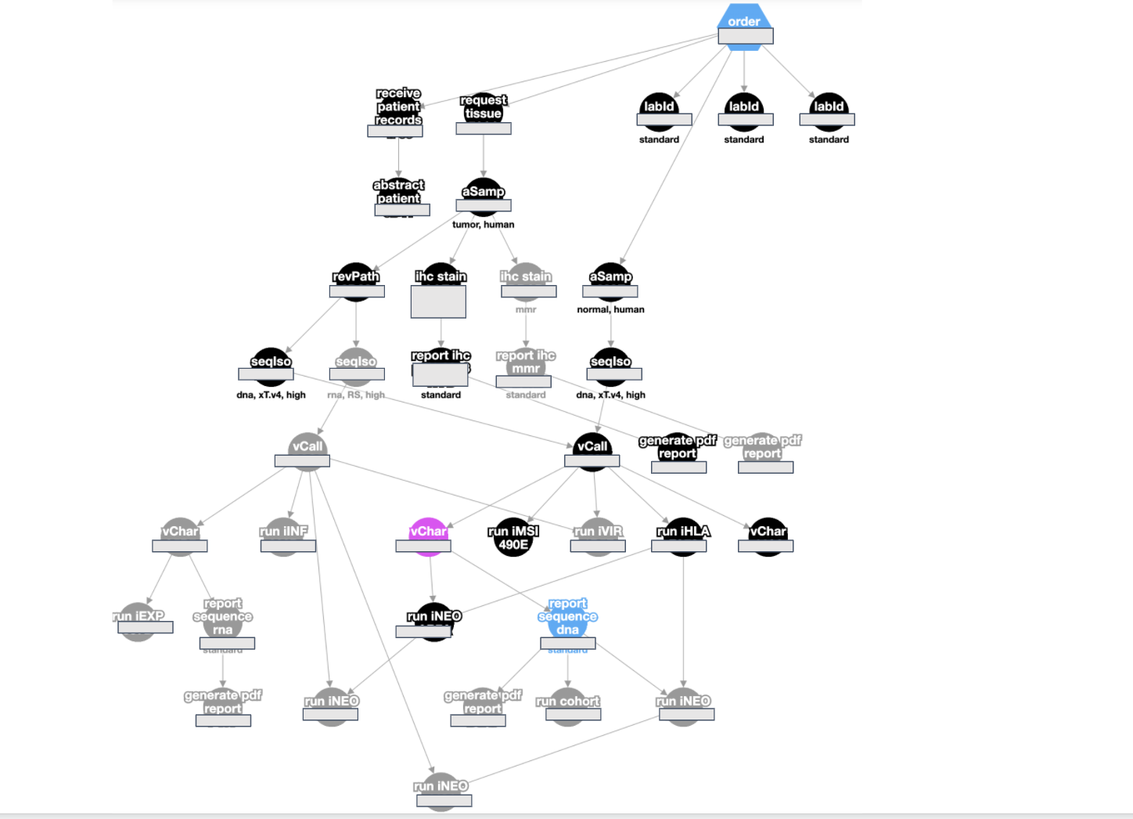
Tumor sequencing
one input to vCall (seqIso)
vCall is followed by vChar

Slide 11
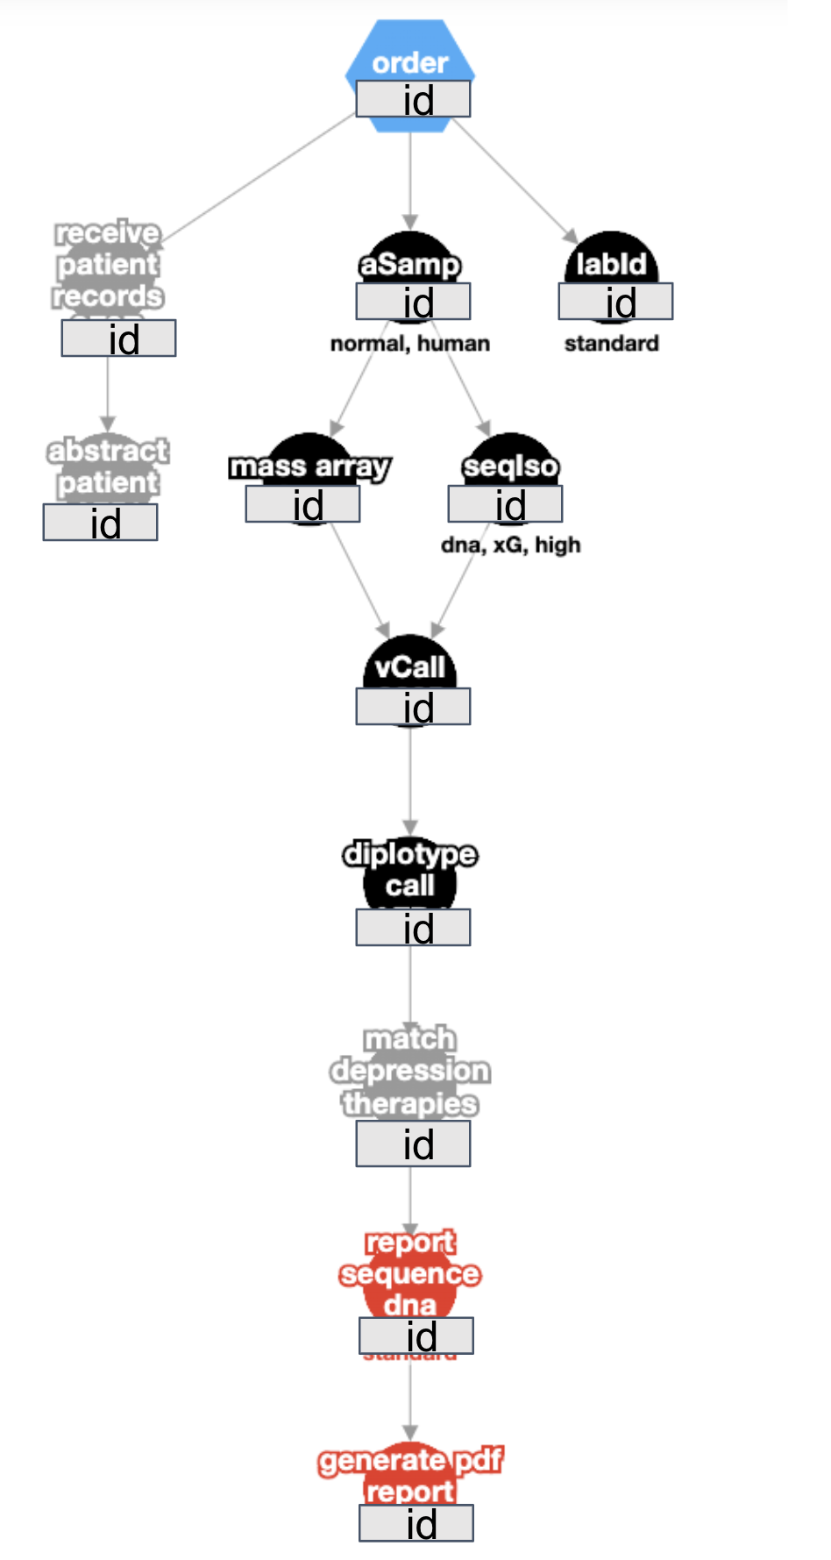
Germline sequencing
mass array and seqIso necessary for vCall
vCall is followed by Dcall
After xG pipeline, → Pike → synapse

Slide 12
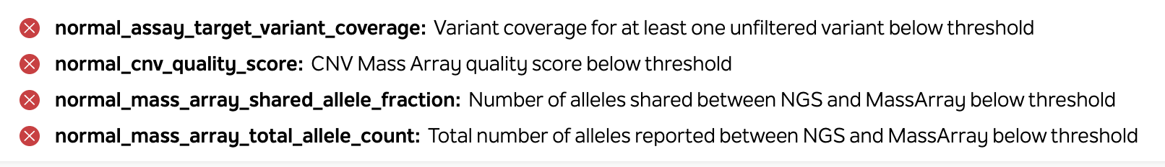
If QC status is null, Dcall will not begin

Slide 13
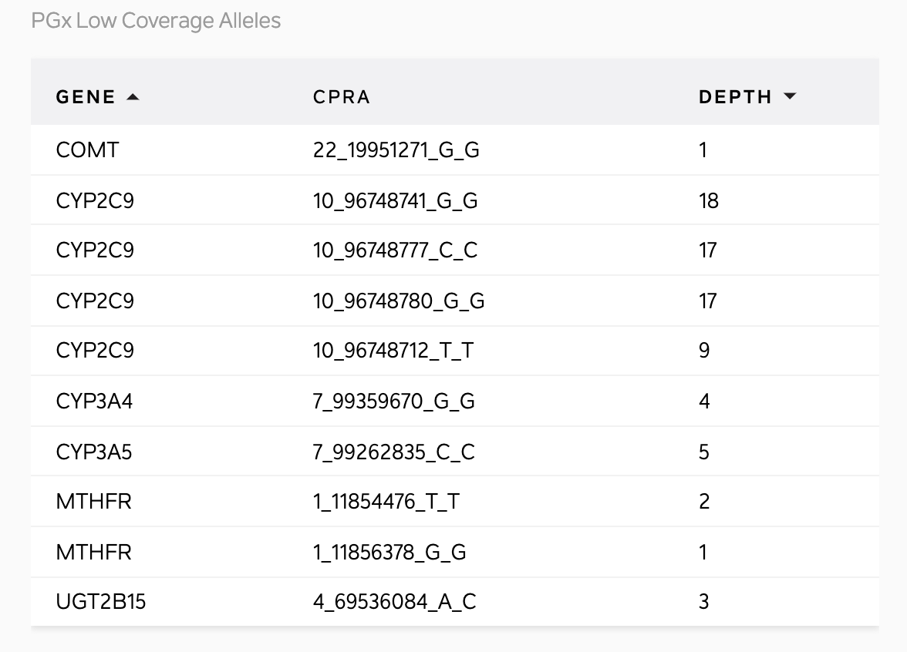
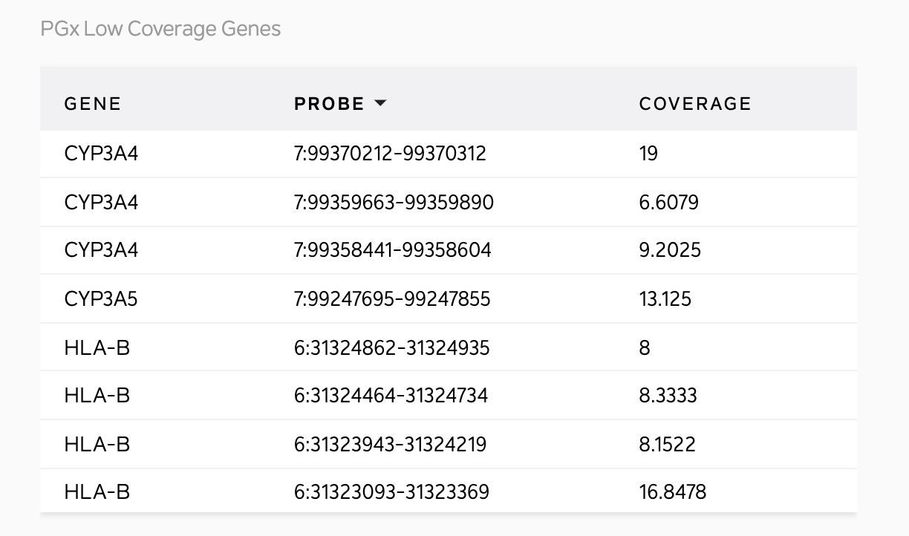
pgx gene coverage (not QC criteria)
defining variant coverage (QC criteria)

Slide 14
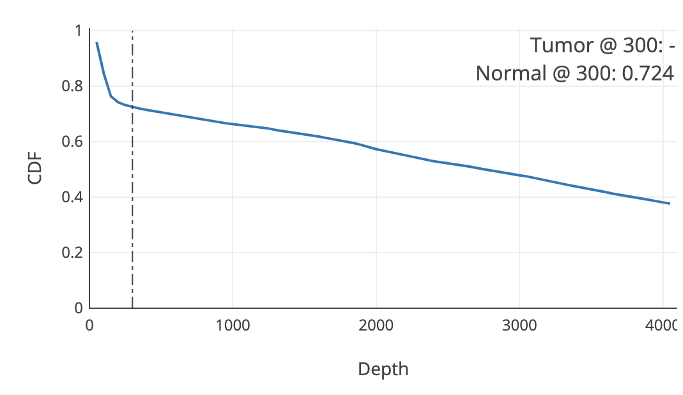
TSQC differences-- coverage
Spiked in genes very high coverage, backbone around 75X
cdf @300 looks quite different

Slide 15
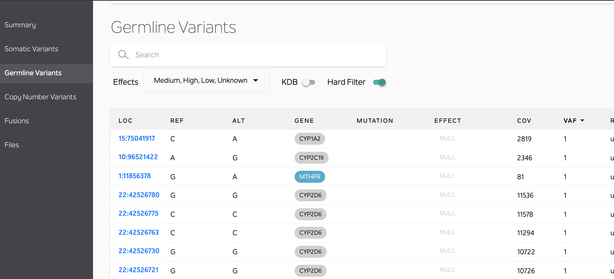
TSQC differences-- turn off all filters

Slide 16
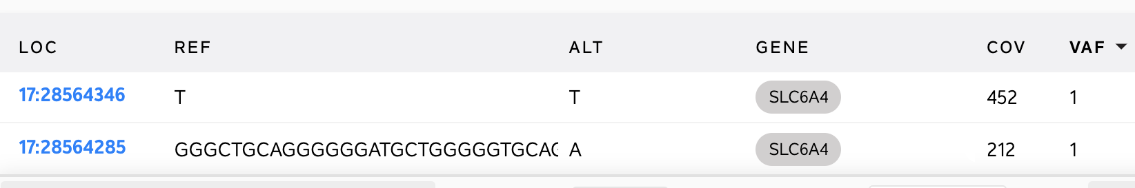
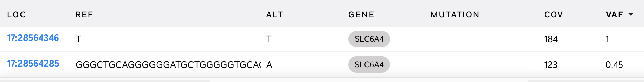
TSQC differences-- variants can be heterozygous or homozygous

Slide 17
Pike
Takes in exome gCSV from xG pipeline, and tsv file from massarray CNV call-- uses pgx database to map variants to star allele designations
Pike outputs a json dataproduct, with star designations for each allele

Slide 18
Synapse
Synapse uses PIKE output and pgx database to map star alleles to diplotypes/phenotypes/potential treatments
Displays this information

Slide 19
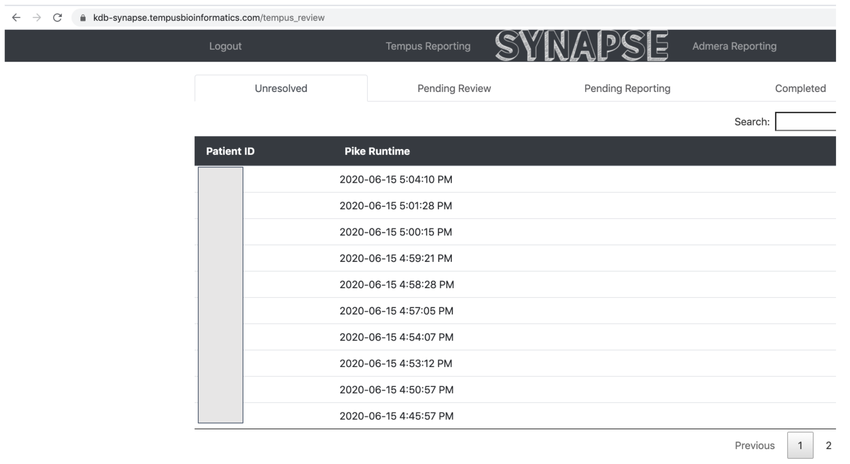

Slide 20
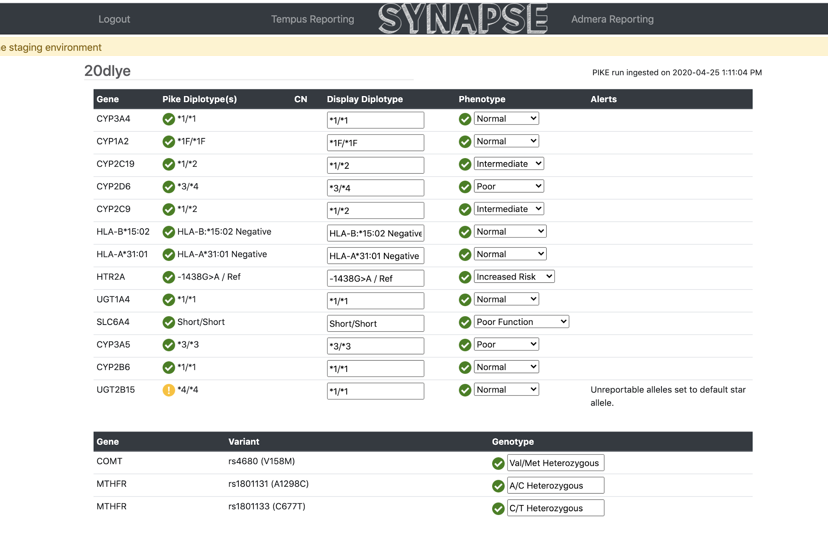
CYP2D6 is the only gene we
currently screen for copy number variants
Long indel in a highly repetitive context

Slide 22
backup

Slide 23
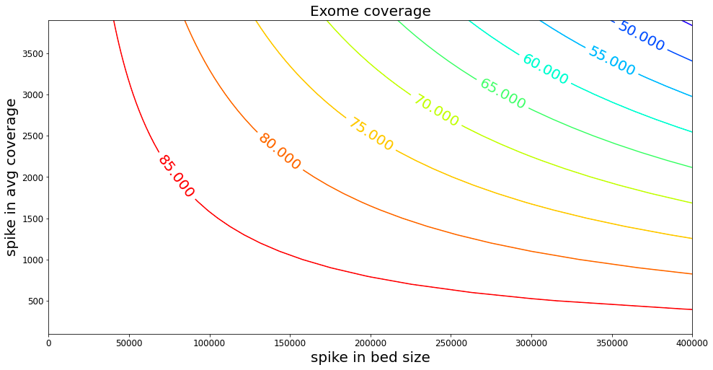
xG probe set evolution
IDT Exome v1/v2
xE_boost
xE_novel
xG_spike_in_1
xG_spike_in_2
xg_v1.0.bed
xg_pgx_define_variants_v1.0.bed
~50 sample per SP flow cell

Slide 24
Bed size
IDT_v2: 34402510
xG_4_spike_in.bed: 206843
Dup_rate: (0.17– 0.28)
Avg total reads: 43,350,000
Avg unique reads: 35,680,000
Avg coverage: 79.58
Avg dv coverage: 1840

